Slide 1
Detecting COVID-19 Using VGG-16

Slide 2
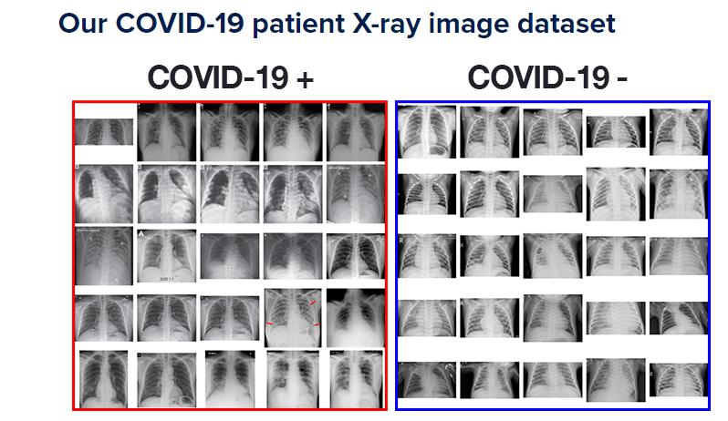
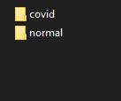
dataset
50 images for train
25 images covid+
25 images covid-

Slide 3
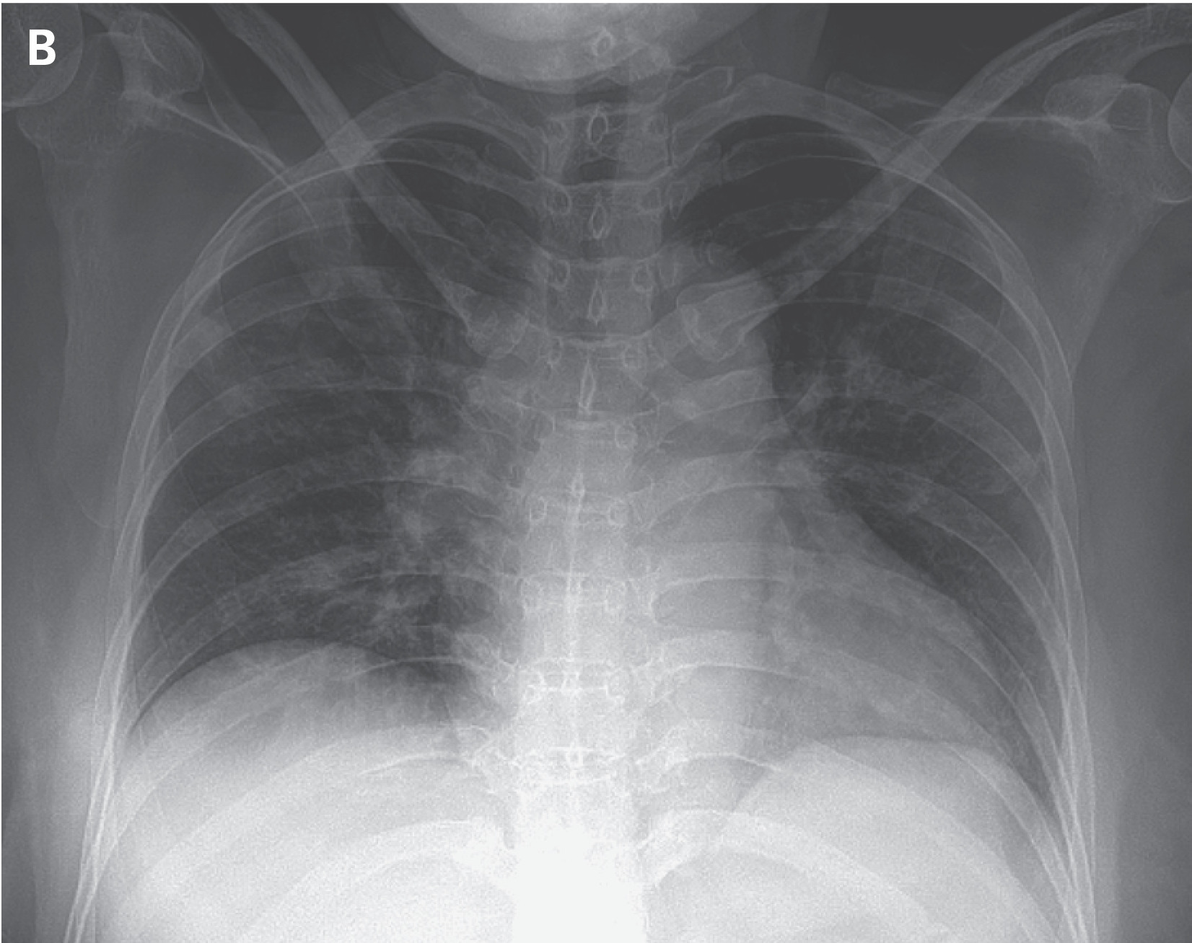
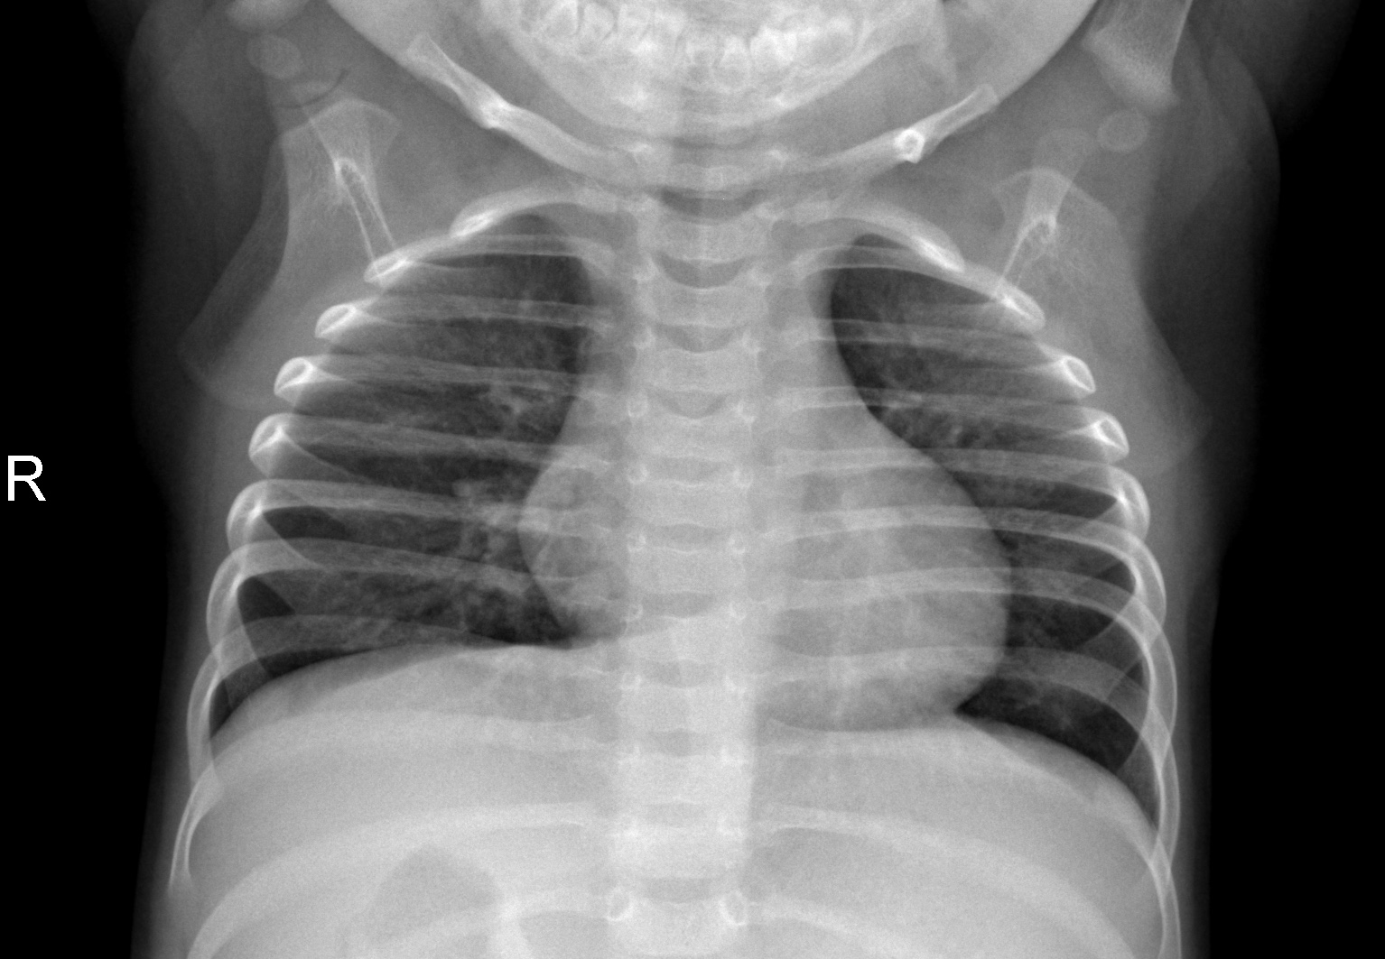
Real sample from Canada hospital
Covid +
Covid -

Slide 4
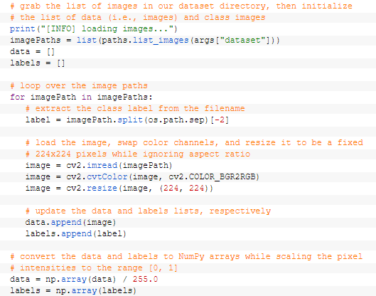
Preprocessing dataset
Resize to 224*224 (because vgg input has special size)
Divide by 255 for normalizing pixels(for converging faster)

Slide 5
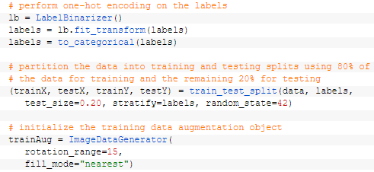
Augmentation and splitting dataset
80% for train,20% for test
For reducing overfit,I have used data augmentation (rotation by 15 degree)

Slide 6

Labeling datset
Label 0 for covid+
Label 1 for covid-

Slide 7
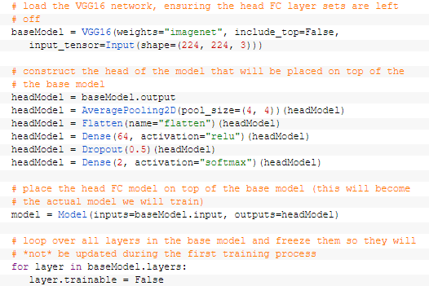
Using VGG16 and fully connected layer
Set input size 224*224*3 for input layer of vgg16 and extracting feature from images
Flatting feature vector by average pooling 4*4
Using one layer fully connected consist of 64 neuron
Using second layer consist of 2 neuron and sigmoid activation function for predicting probability of target image

Slide 8
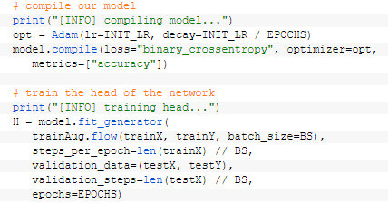

Fitting model
Using Adam optimizer
Using binary_crossentropy loss function
Learning rate=0.001
Epochs=25
Batch size=8

Slide 9
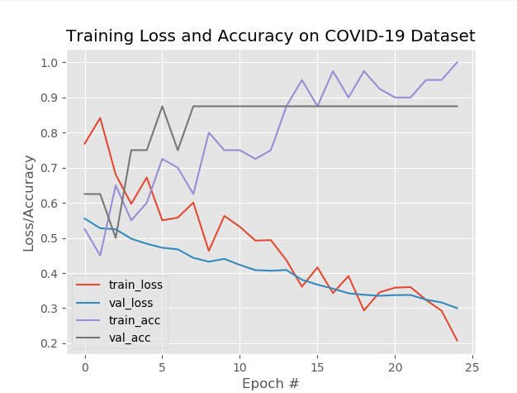
Results of model
Training loss and validation loss are decreasing(after 25 epochs)
Training accuracy and validation accuracy are increasing(after 25 epochs)

Slide 10


Confusion matrix
Testing 10 images(5 images have covid and 5 images do not have covid)
Achieving 90 % accuracy in test set images
Among 5 images that don’t have covid and models predict correctly
Among 5 images have covid-19 ,the model predict 4 images correctly and predict one image wrong
For improving results,we can enable to increase dataset

Slide 11
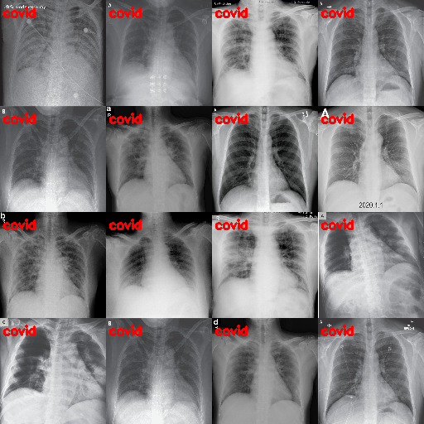
Testing model on covid+
Model predict correctly images that have covid-19

Slide 12
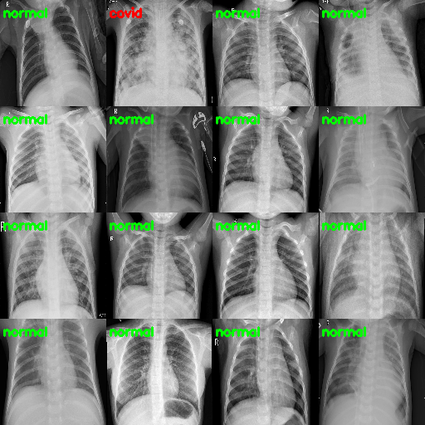
Testing model on covid- (healthy images)
Model has 1 missing predict while 15 images are predicted correctly.

